Slide 1
WIRELESS SENSOR NETWORK BASED SMART IRRIGATION SYSTEM
SRIJA GADDAM
VINEELA NEELAM
NAVYASREE THIRUNAGARI

Slide 2
CONTENTS
INTRODUCTION
COMPONENTS USED
WORKING
APPLICATION
CONCLUSION

Slide 3
INTRODUCTION
Irrigation is mostly done using canal systems in which water is pumped into fields after regular interval of time without any feedback of water level in field.
In order to solve the problem the smart irrigation system using wireless sensor network has been devised. This method is contrary to a traditional irrigation method, regulates supplied water according to the needs of the fields and crops using moisture sensor mechanism.

Slide 4


Slide 5
SENSORS
DHT 11
Soil moisture
sensor

Slide 6
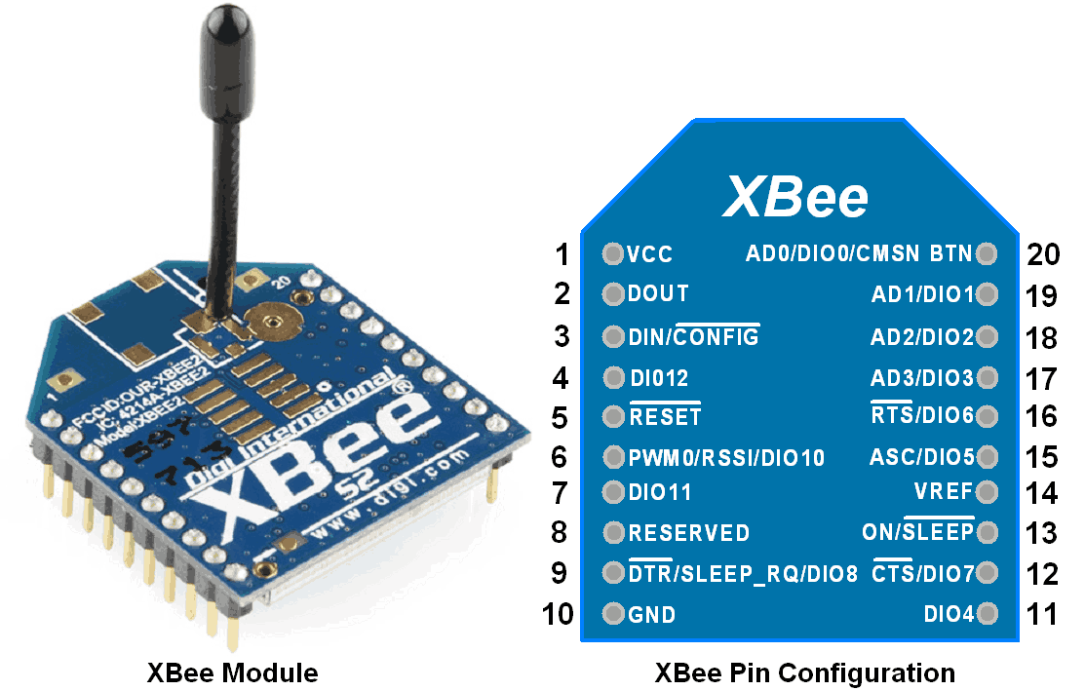
XBEE MODULE

Slide 7
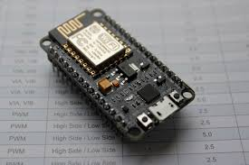
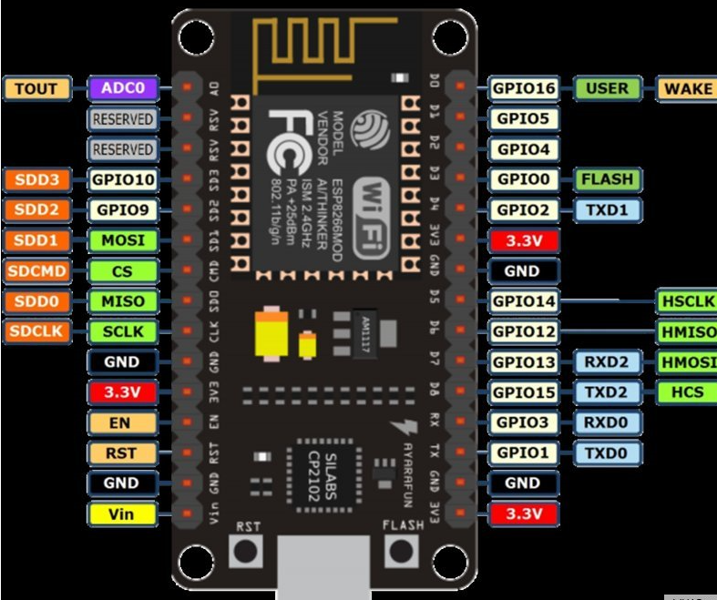
NODE MCU ESP8266-12E

Slide 8
MINI WATER PUMP
L293d

Slide 9
WORKING

Slide 10




Slide 11
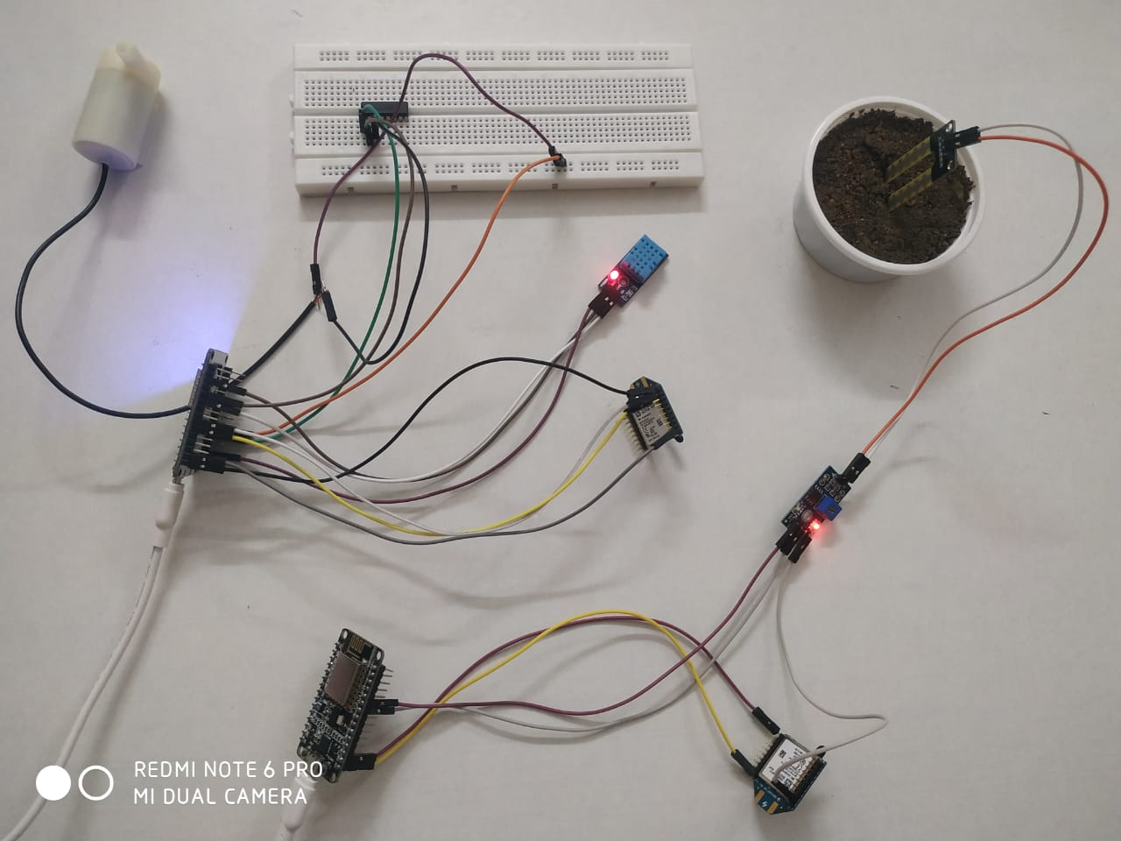

Slide 12
APPLICATION
In this project the data that is sensed by the soil moisture sensor is sent to the XBee module.
XBee modules communicate with each other and automatically operates the water pump as per the plant requirement.
The data (temperature , humidity and moisture)can be monitored by the farmer through a mobile app application.

Slide 13
CONCLUSION
This project is easily deployable and can be manually or automatically without physical presence at the field.
By this we can facilitate continuous cropping, can improve the groundwater storage, to cool both soil and plant , to supply water for crop need.

